Slide 1
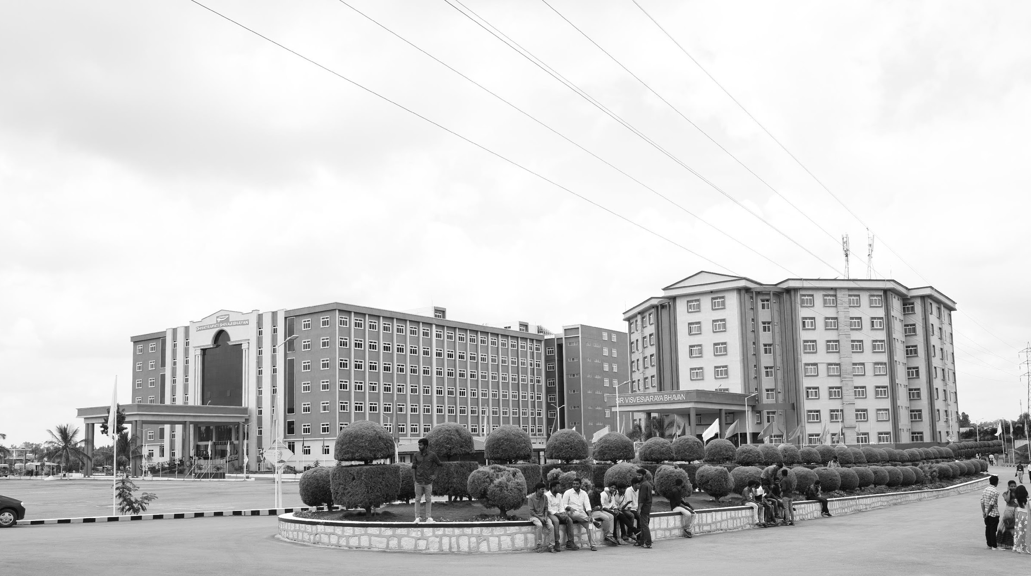

VISUAL SLAM BASED AUTONOMOUS ROBOT
Mid-Review 1/2/3
Major Project
Project ID: A6
AY 2021-25
GITAM (Deemed-to-be) University
Project Team:
M.DIWAKAR REDDY
D.VINAY KUMAR
G.MAHESH REDDY
Department of Electrical Electronics and Communication Engineering
Project Mentor:
H.J.JAYATHEERTHA
Project In-charge:
DR.PANKAJ KANDWAY
www.gitam.edu

Slide 2
Objective and Goals
Objective
The objective of the Visual SLAM-based autonomous robot project is to develop a system that allows the robot to navigate and map its environment autonomously using visual inputs from cameras. This involves integrating advanced computer vision techniques to detect and track features, estimate the robot's position, and continuously update a detailed map of the surroundings. The goal is to achieve accurate, real-time localization and mapping, enabling the robot to operate efficiently in dynamic and unstructured environments without human intervention.
Goals
Main Goals
Real-Time Navigation: Enable the robot to autonomously navigate through its environment using visual data, avoiding obstacles and following predefined paths.
Accurate Localization: Ensure precise estimation of the robot’s position and orientation within the environment based on visual inputs.
Map Creation and Updating: Develop and continuously update a detailed map of the environment, capturing both static and dynamic features.
Additional Goals
Integration with Other Sensors: Incorporate additional sensors, like IMUs or LiDAR, to enhance accuracy and provide redundancy.
User Interface and Visualization: Create tools for visualizing the robot’s path and the generated map, facilitating user interaction and analysis.

Slide 3
Project Plan
Research and Planning | 3 weeks
System Design | 6 weeks
Development and Prototyping | 8 weeks
Testing and Validation | 5 weeks
Deployment and Documentation | 2 weeks

Slide 4
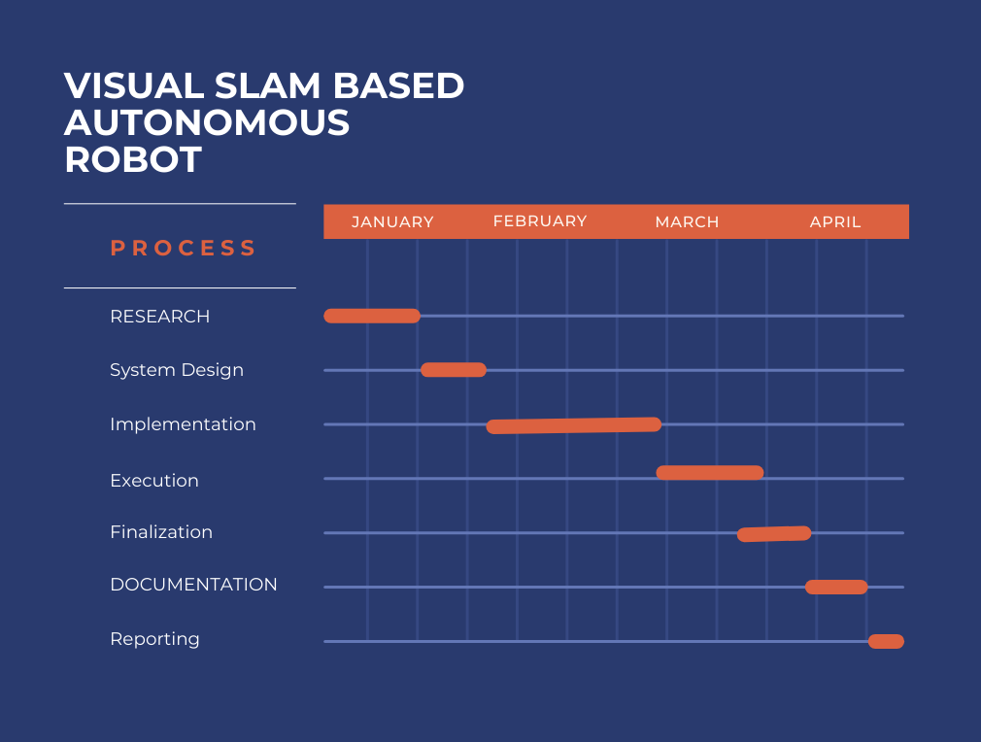
Project Plan

Slide 5
Literature Survey (Improved post minor project)
NAME | PUBLISHED DATE | AUTHOR NAME | ABSTRACT
A Review on Visual-SLAM: Advancements from Geometric Modelling to Learning-Based Semantic Scene Understanding Using Multi-Modal Sensor Fusion | 25 September 2022 | Tin Lai | Simultaneous Localisation and Mapping (SLAM) is one of the fundamental problems in autonomous mobile robots where a robot needs to reconstruct a previously unseen environment while simultaneously localising itself with respect to the map. In particular, Visual-SLAM uses various sensors from the mobile robot for collecting and sensing a representation of the map. Traditionally, geometric model-based techniques were used to tackle the SLAM problem, which tends to be error-prone under challenging environments.
vSLAM: vision-based SLAM for autonomous vehicle navigation | 2 September 2004 | Niklas Karlsson, Jim Ostrowski, Enrico Di Bernardo, Paolo Pirjanian | Among the numerous challenges of building autonomous/unmanned vehicles is that of reliable and autonomous localization in an unknown environment. In this paper we present a system that can efficiently and autonomously solve the robotics 'SLAM' problem, where a robot placed in an unknown environment, simultaneously must localize itself and make a map of the environment. The system is vision-based, and makes use of Evolution Robotic's powerful object recognition technology. As the robot explores the environment, it is continuously performing four tasks, using information from acquired images and the drive system odometry.

Slide 6
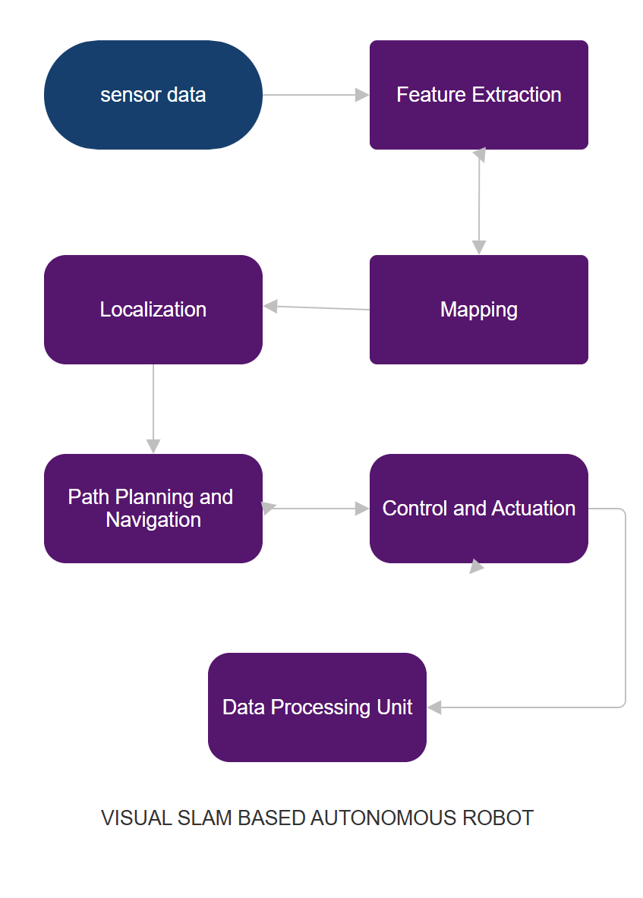
Architecture

Slide 7
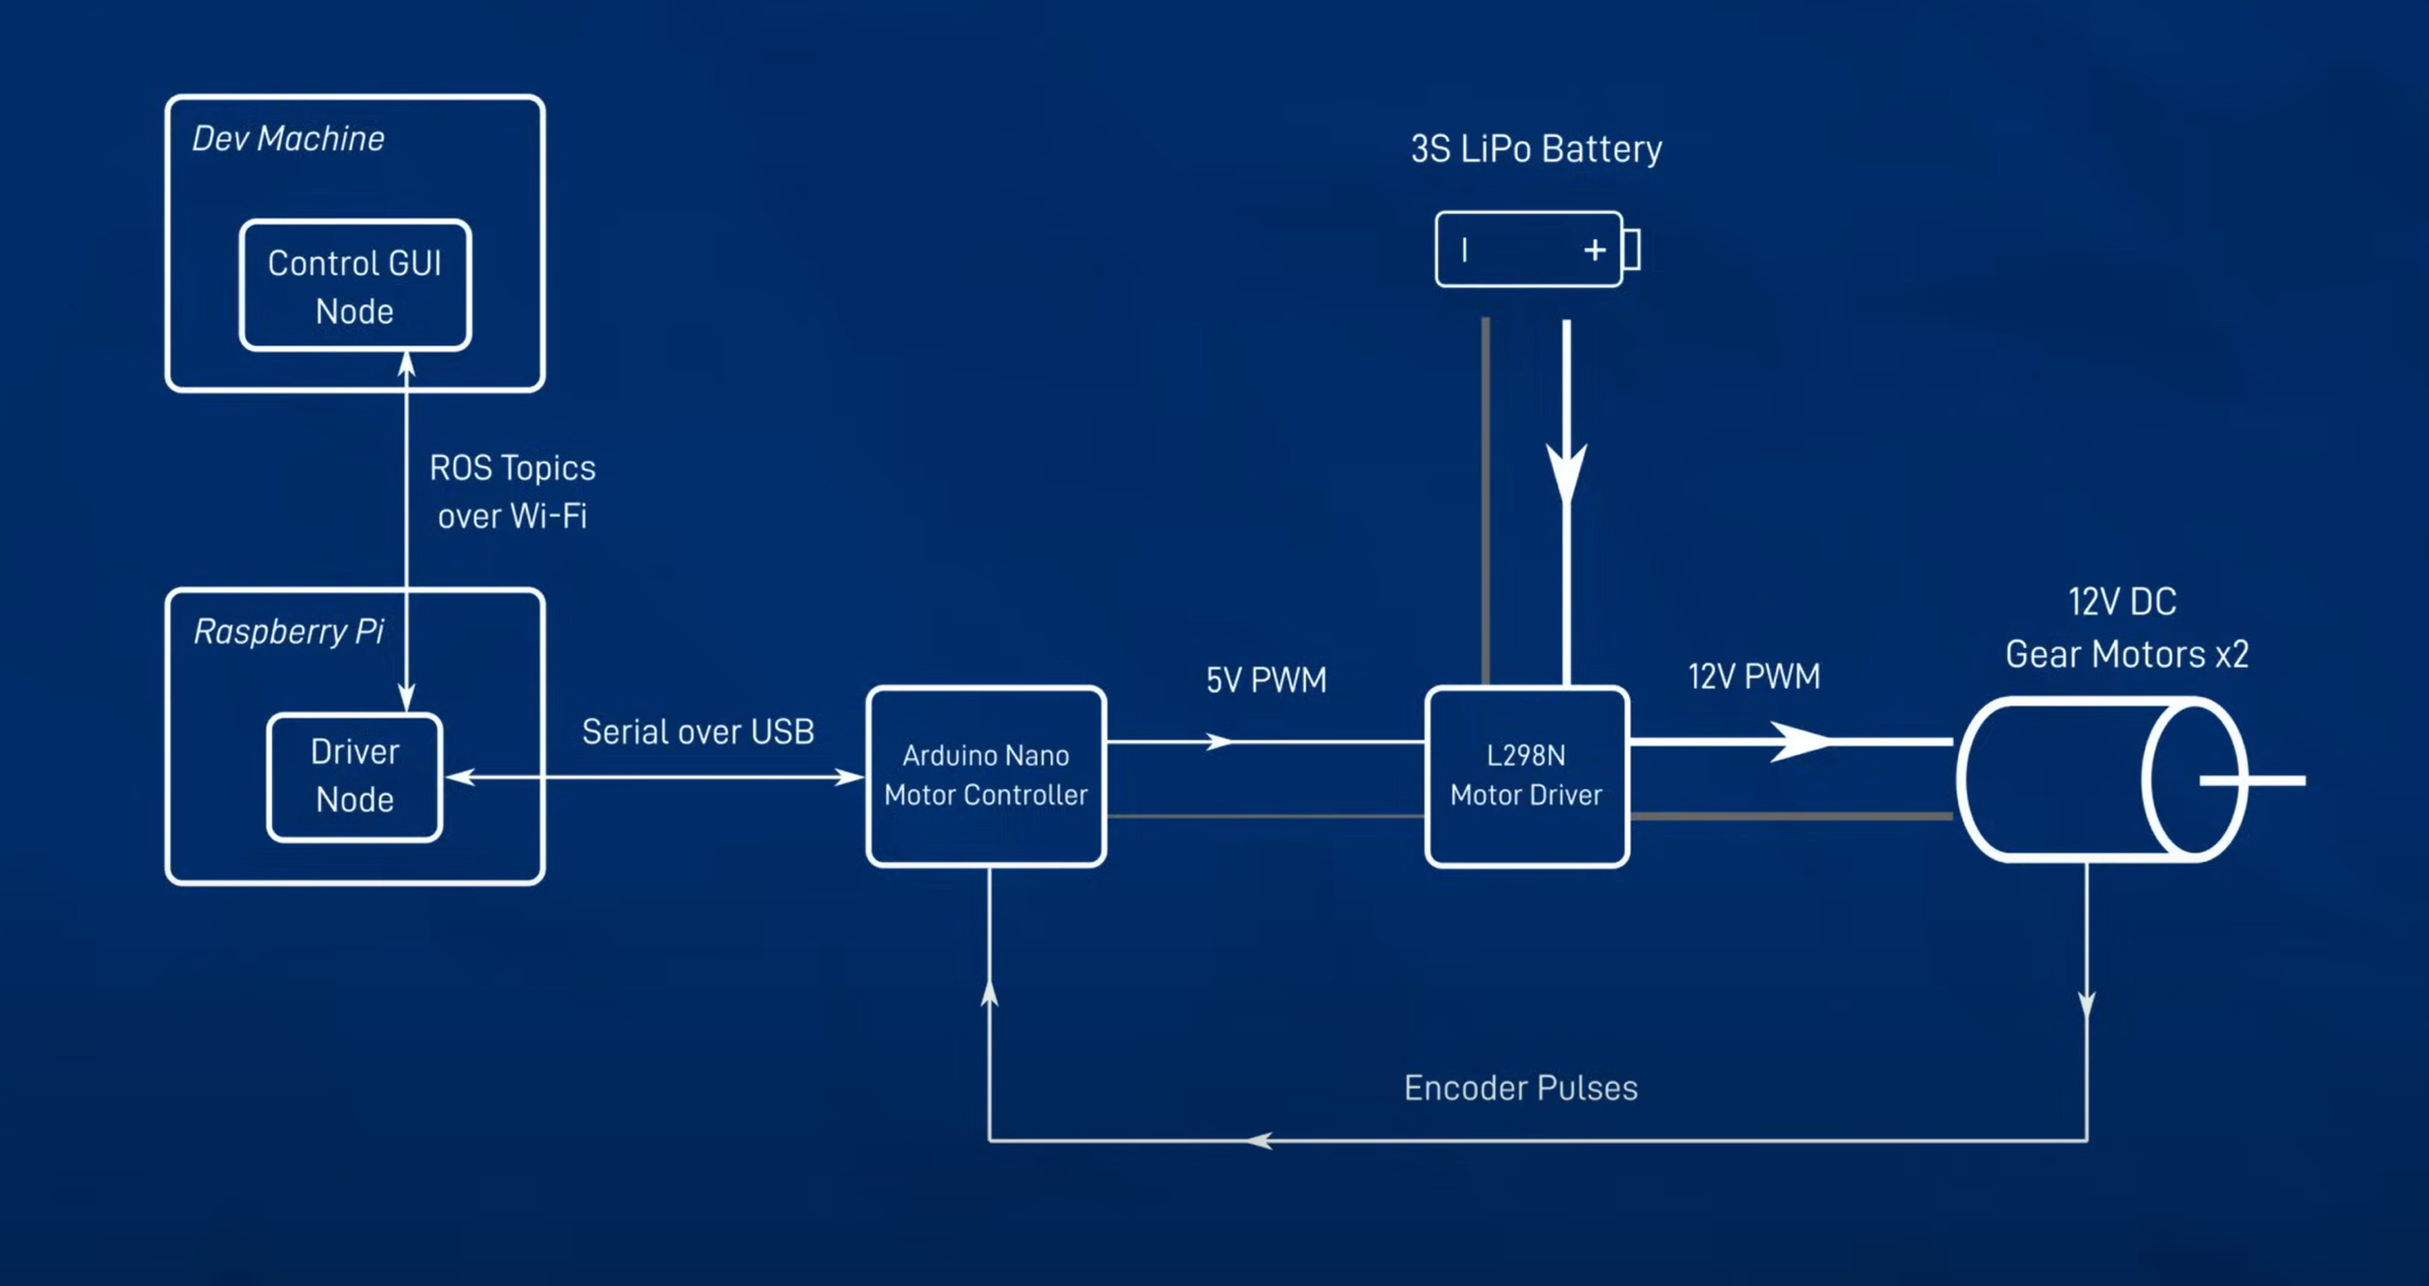

Slide 8
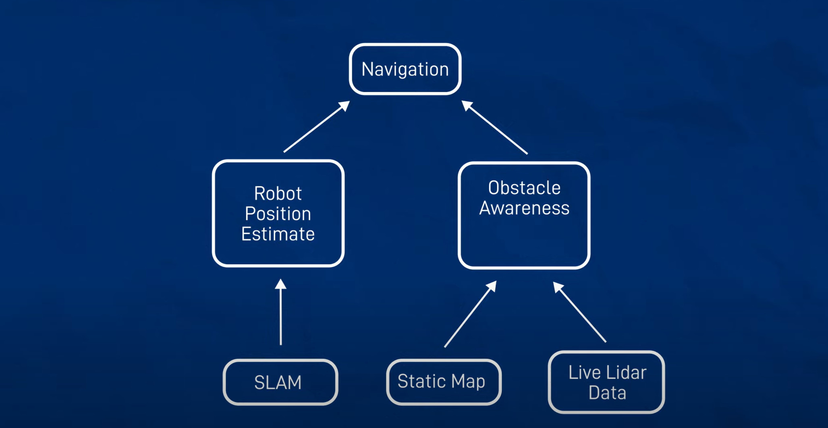

Slide 9
Use Cases & Testing
Use Cases
Indoor Navigation
Autonomous Delivery
Surveillance
Cleaning Robots
Test Cases
Mapping Accuracy:
Verify if the robot can create accurate maps of a given indoor environment.
Localization Consistency:
Test the robot’s ability to consistently localize itself in the mapped environment, even after movement or turning off/on.
Obstacle Avoidance:
Place dynamic obstacles in the path and ensure the robot can detect and navigate around them.
Path Planning:
Test if the robot can plan and execute an optimal path from one point to another without collisions.

Slide 10
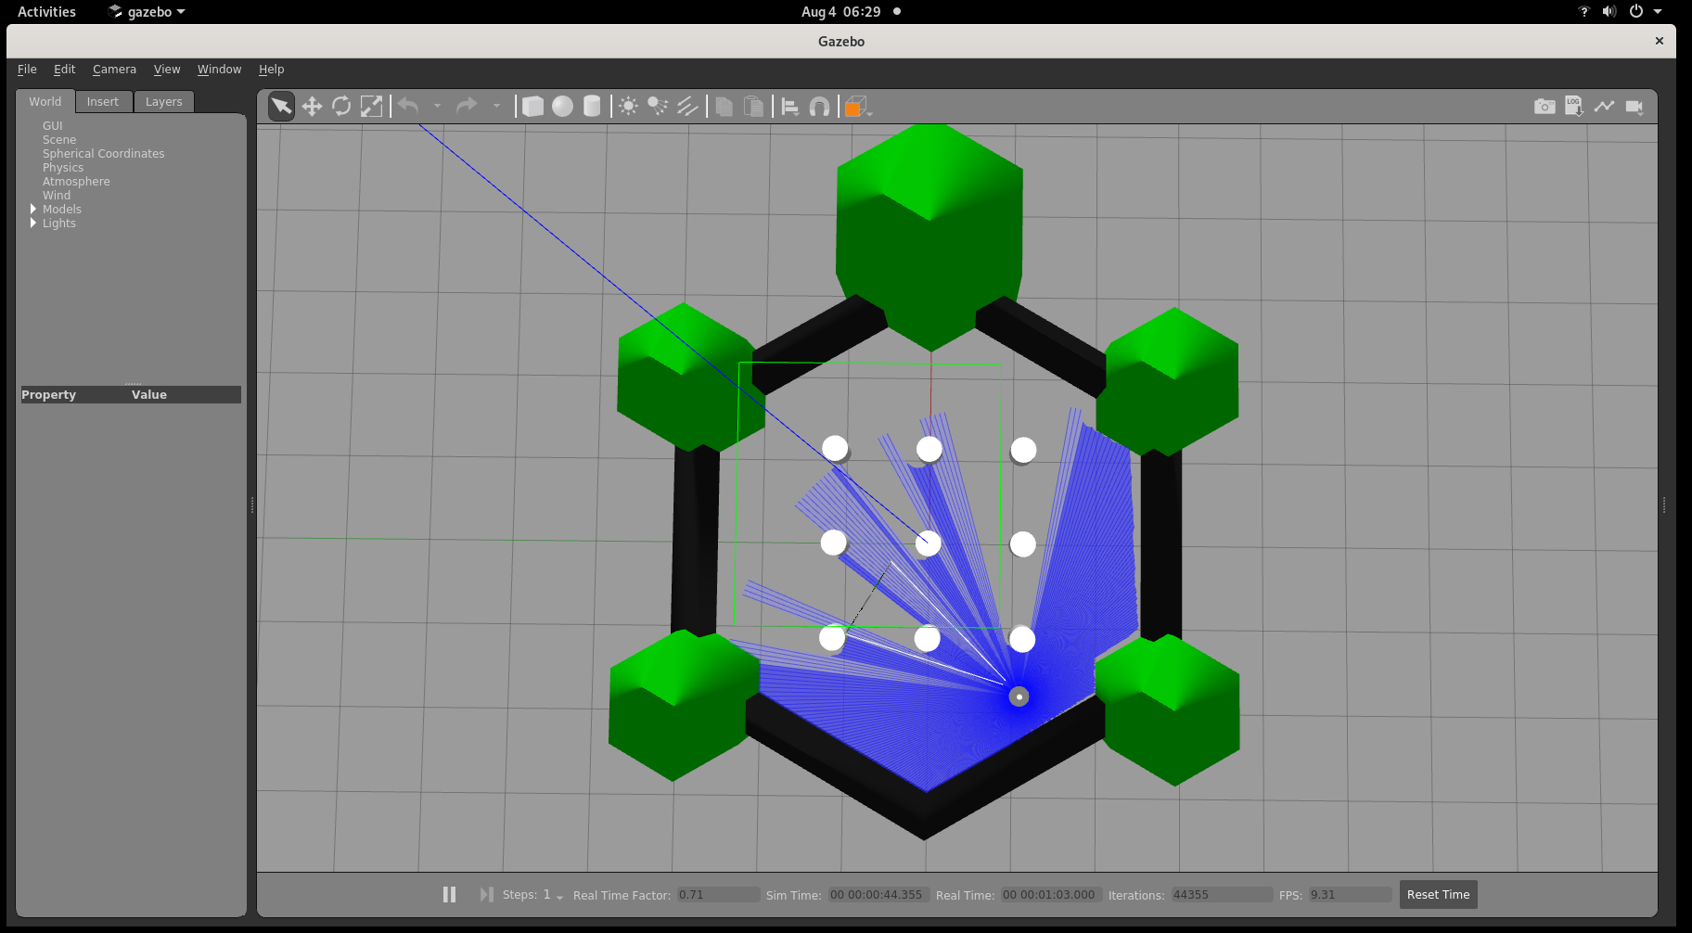
Implementation and Results

Slide 11
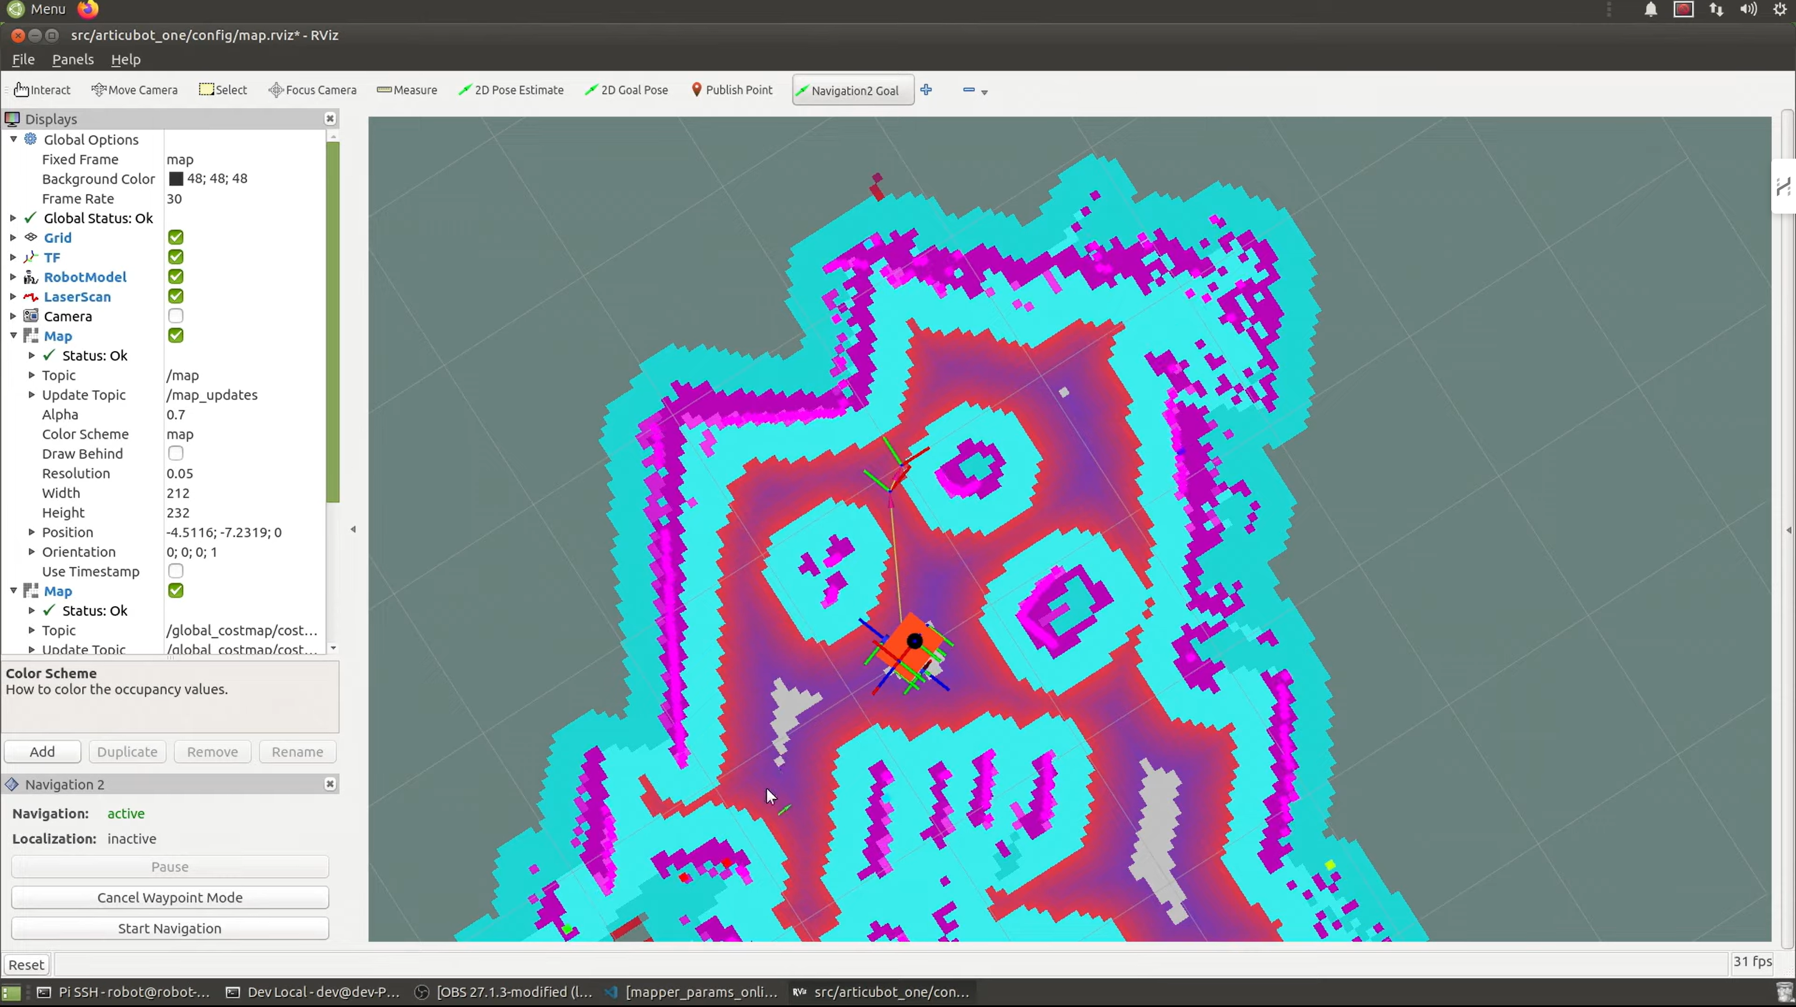
Implementation and Results

Slide 12
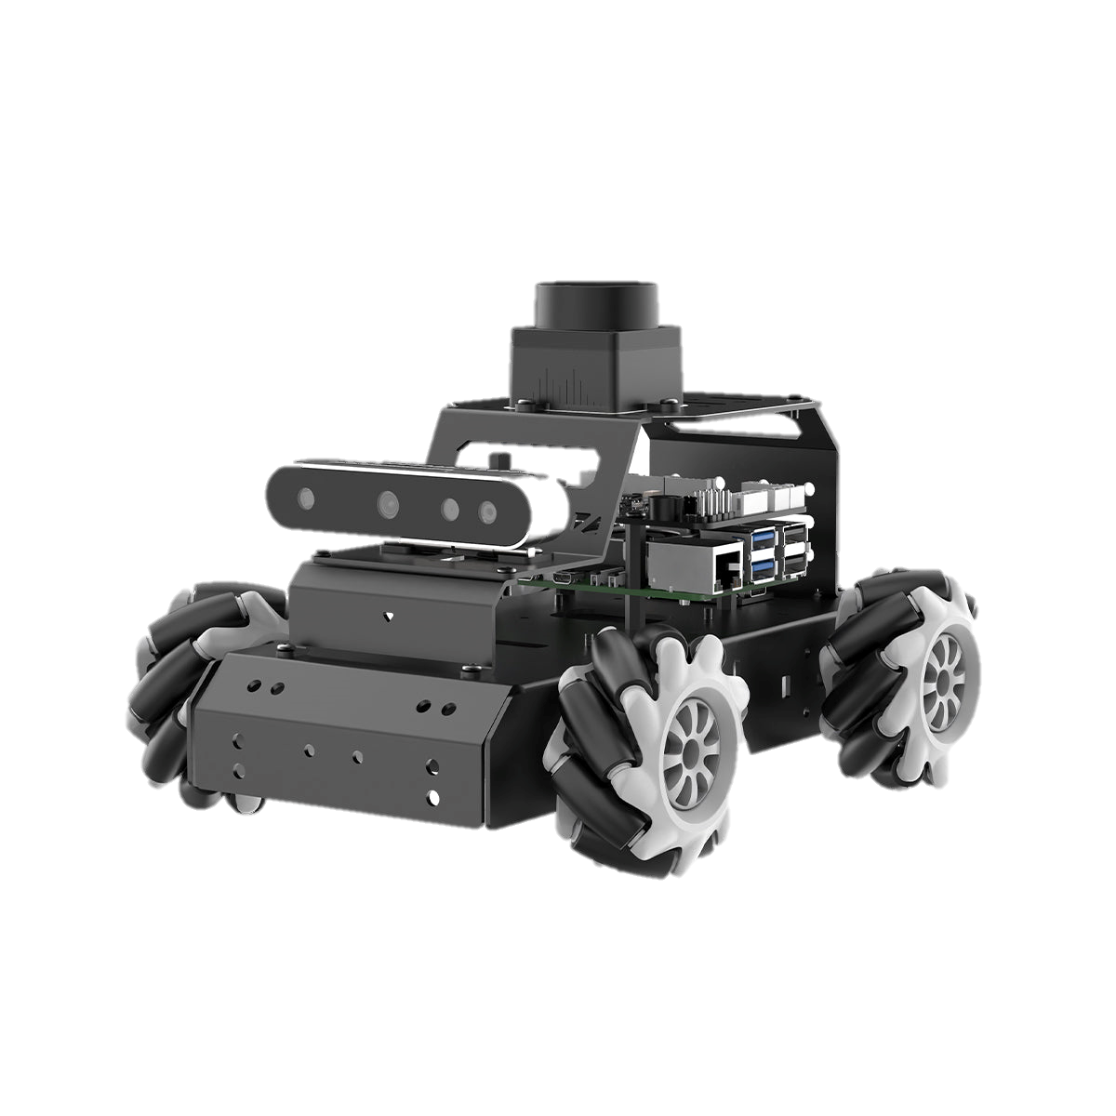
Implementation and Results – Iteration 2

Slide 13
Contribution
Team Progress and Movement
learning about new softwares and understanding how the components actually work
Facing new challenges and overcoming those challenges
PREPARING DETAILED DOCUMENTATION AND REPORTING FOR THE PROJECT.
COLLABORATION WITH MENTORS AND EXPERTS TO GAIN INSIGHTS AND FEEDBACK.
WEEKLY TEAM MEETINGS TO DISCUSS PROGRESS, CHALLENGES, AND UPCOMING TASKS IMPLEMENT REAL-TIMEMONITORING AND SELF- HEALING CAPABILITIES
Individual Contribution
Key contributions: M.DIWAKAR REDDY
Hardware Setup
Research and Development
Key contributions: G.MAHESH REDDY
Analysis
Documentation
Key contributions: D.vinay kumar
Literature survey
External works

Slide 14
Conclusion & Future Work
Summary and Conclusion
This project demonstrated the effectiveness of Visual SLAM for autonomous robots, enabling real-time mapping and navigation. While the system is effective indoors, future enhancements like multi-sensor fusion, outdoor scalability, and AI-driven decision-making can extend its capabilities. These improvements will enable real-world applications, advancing autonomous robotics in various industries.
Future Work
Enhance SLAM performance in dynamic and unstructured environments.
Introduce multi-sensor fusion (e.g., LiDAR, IMU) for improved localization.
Develop advanced algorithms for autonomous navigation and obstacle avoidance.
Adapt the system for outdoor environments with GPS integration.
Focus on hardware efficiency for prolonged autonomous operation.
Apply the technology to fields like agriculture, delivery, and warehouse automation.

Slide 15
THANK YOU
Have a Great Day !

